Slide 1

Chapter 1
ALGORITHM ANALYSIS
算法分析
主讲教师： 王晓茹
Wang, Xiaoru

Slide 2
1.算法及算法复杂度
站得高，看的远
CONCEPT OF ALGORITHM

Slide 3

CHAPTER 1
ALGORITHM ANALYSIS
【Definition】An algorithm is a finite set of instructions that, if followed, accomplishes a particular task. In addition, all algorithms must satisfy the following criteria:
(1) Input There are zero or more quantities that are externally supplied.
(2) Output At least one quantity is produced.
(3) Definiteness（确定性）Each instruction is clear and unambiguous.
(4) Finiteness（有限性）If we trace out the instructions of an algorithm, then for all cases, the algorithm terminates after finite number of steps.
(5) Effectiveness Every instruction must be basic enough to be carried out, in principle, by a person using only pencil and paper. It is not enough that each operation be definite as in(3); it also must be feasible.

Slide 4
Note: A program is written in some programming language, and does not have to be finite (e.g. an operation system).
An algorithm can be described by human languages, flow charts, some programming languages, or pseudo-code.
〖Example〗 Selection Sort: Sort a set of n ≥ 1 integers in increasing order.
From those integers that are currently unsorted, find the smallest and place it next in the sorted list.
Where and how
are they stored?
for ( i = 0; i < n; i++) {
Examine list[i] to list[n−1] and suppose that the smallest integer is at list[min];
Interchange list[i] and list[min];
}
Where?
Algorithm in
pseudo-code
Sort = Find the smallest integer + Interchange it with list[i].

Slide 5
本课程中算法的描述方法
C/C＋＋语言
优点：大家学过，类型丰富，语句精炼，具有面向对象和面向过程的双重特点。
C/C++语言与自然语言相结合
C/C++

Slide 6
算法的分析和评价
对于解决同一个问题，往往能够编写出许多不同的算法。
进行算法分析和评价的目的，即在于从解决同一问题的不同算法中选择较为合适的一种，也在于知道如何对现有算法进行改进，从而可能设计出更好的算法。

Slide 7
如何评价算法？
时间复杂性
和
空间复杂性
正确性
简单性
健壮性
可读性
复杂性
时间复杂性和空间复杂性
Notes:
模板来自于 http://docer.wps.cn

Slide 8
算法复杂性分析
算法复杂性 = 算法运行所需要的计算机资源的量，其中需要时间资源的量称为时间复杂性；需要空间（存储器）资源的量称为空间复杂性。
C=F(N,I,A)，其中C＝复杂性；N＝算法要解决问题的规模；I＝算法的输入；A＝算法本身
时间复杂性T＝T(N,I);空间复杂性C=C(N.I）
算法的时间复杂性T(n)；
算法的空间复杂性S(n)。
其中n是问题的规模（输入大小）。

Slide 9
本课程所研究的算法复杂性
时间复杂性和空间复杂性的量计算方法相似，并且空间复杂性的计算更简单，因此本课程主要以时间复杂性计算为主；

Slide 10
时间复杂性／复杂度
又称计算复杂度，是一个算法运行时间的相对度量。
一个算法的运行时间是指在计算机上从开始到结束运行所花费的时间，它大致等于计算机执行一种简单操作（如赋值、比较、计算、转向、返回、输入、输出等）所需的时间与算法中进行简单操作次数的乘积。
运行时间
由于执行一种简单操作所需的时间随着机器而异，它是机器本身硬软件环境决定的，与算法无关，所以我们只讨论影响运行时间的另一个因素——算法中进行简单操作的次数。
相对度量

Slide 11
时间复杂性／复杂度
又称计算复杂度，是一个算法运行时间的相对度量。
不管一个算法是简单还是复杂，最终都是被分解成简单操作来具体执行，因此每个算法都对应着一定的简单操作的次数。显然，在一个算法中，进行简单操作的次数越少，其运行时间也就相对地减少；次数越多，其运行时间也就相对地越多。
运行时间
所以，通常把算法中包含简单操作次数的多少叫做算法的时间复杂度，用它来衡量一个算法的运行时间性能或称计算性能。
相对度量

Slide 12
时间复杂度函数T(n)
函数定义
若解决一个问题的规模为n，例如在排序问题中，n表示待排元素的个数；在矩阵计算中，n表示矩阵的阶数；在图的遍历中，n表示途中的顶点数。
T(n)
算法的时间复杂度就是n的一个函数，通常记作：T(n).

Slide 13
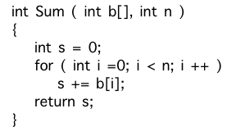
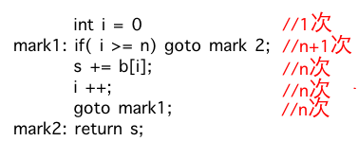
举例：累加求和

Slide 14
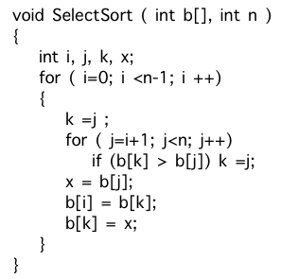
举例：简单选择排序

Slide 15
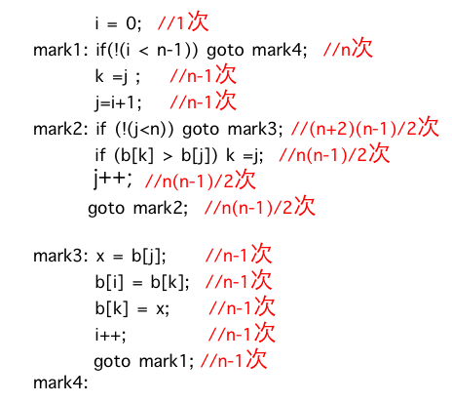


Slide 16
2.算法复杂度分析
站得高，看的远
What to Analyze

Slide 17
§What to Analyze
➢ Machine & compiler-dependent run times.
➢ Time & space complexities : machine & compiler-independent.
Assumptions:
① instructions are executed sequentially
② each instruction is simple, and takes exactly one time unit
③ integer size is fixed and we have infinite memory
Typically the following two functions are analyzed:
T_{avg}(N) & T_{worst}(N) -- the average and worst case time complexities, respectively, as functions of input size N.
If there is more than one input, these functions may have more than one argument.

Slide 18
§1 What to Analyze
〖Example〗 Matrix addition
void add ( int a[ ][ MAX_SIZE ],
int b[ ][ MAX_SIZE ],
int c[ ][ MAX_SIZE ],
int rows, int cols )
{
int i, j ;
for ( i = 0; i < rows; i++ )
for ( j = 0; j < cols; j++ )
c[ i ][ j ] = a[ i ][ j ] + b[ i ][ j ];
}
Q: What shall we do
if rows >> cols?
A: Exchange
rows and cols.
/* rows + 1 */
/* rows(cols+1) */
/* rows ⋅ cols */
T(rows, cols ) = 2 rows ⋅ cols + 2rows + 1

Slide 19
§1 What to Analyze
float sum ( float list[ ], int n )
{ /* add a list of numbers */
float tempsum = 0;
int i ;
for ( i = 0; i < n; i++ )
tempsum += list [ i ] ;
return tempsum;
}
〖Example〗Iterative function for summing a list of numbers
/* count = 1 */
/* count ++ */
/* count ++ */
T_{sum} ( n ) = 2n + 3
/* count ++ for last execution of for */
/* count ++ */
〖Example〗Recursive function for summing a list of numbers
float rsum ( float list[ ], int n )
{ /* add a list of numbers */
if ( n )
return rsum(list, n−1) + list[n − 1];
return 0;
}
/* count ++ */
T_{rsum} ( n ) = 2n + 2
But it takes more time to compute each step.
/* count ++ */
/* count ++ */
Notes:
递归与迭代的效率比较
我们知道，递归调用实际上是函数自己在调用自己，而函数的调用开销是很大的，系统要为每次函数调用分配存储空间，并将调用点压栈予以记录。而在函数调用结束后，还要释放空间，弹栈恢复断点。所以说，函数调用不仅浪费空间，还浪费时间。
这样，我们发现，同一个问题，如果递归解决方案的复杂度不明显优于其它解决方案的话，那么使用递归是不划算的。因为它的很多时间浪费在对函数调用的处理上。在C++中引入了内联函数的概念，其实就是为了避免简单函数内部语句的执行时间小于函数调用的时间而造成效率降低的情况出现。在这里也是一个道理，如果过多的时间用于了函数调用的处理，那么效率显然高不起来。
但是递归算法要进行n次函数调用，而迭代算法则只需要进行n次迭代而已。其效率上的差异是很显著的。

Slide 20
§1 What to Analyze
Take the iterative and
recursive programs for summing
a list for example --- if you think 2n+2 is
less than 2n+3, try a large n and
you’ll be surprised !
I see ...
Then what’s the point of
this T_{p} stuff?
So it’s too complicated sometimes.
But does it worth the effort?
Is it really necessary
to count the exact
number of steps ?
Uhhh ...
I don’t think so.
Good question !
Let’s ask the students ...
Because
it drives me crazy!
Why?

Slide 21
2.算法复杂度分析之 渐进性复杂性分析
站得高，看的远
Asymptotic Notation

Slide 22

§2 Asymptotic Notation ( Ο, Ω, Θ, o ）渐进性原理及表示符号
The point of counting the steps is to predict the growth in run time as the N change, and thereby compare the time complexities of two programs. So what we really want to know is the asymptotic behavior of T_{p}.
Suppose T_{p1} ( N ) = c₁N² + c₂N and T_{p2} ( N ) = c₃N. Which one is faster?
No matter what c₁, c₂, and c₃ are, there will be an n₀ such that T_{p1} ( N ) > T_{p2} ( N ) for all N > n₀.
I see! So as long as I know that
T_{p1} is about N² and T_{p2} is about N, then for
sufficiently large N, P2 will be faster!

Slide 23
算法渐近复杂性
衡量算法复杂性的档次/规模——阶， Rate/Order of growth
对时间复杂性函数T(n)，有可能，T(n) →∞ , as n→∞ ;
例如，
T(n) = 2n² + 4n + 1， t(n)= 2n²
(T(n) - t(n) ) / T(n) →0 ，as n→∞;
t(n)是T(n)的渐近性态，为算法的渐近复杂性。
在数学上， t(n)是T(n)的渐近表达式，是T(n)略去低阶项留下的主项。它比T(n) 简单。

Slide 24
§2 Asymptotic Notation
【Definition】 T (N) = O( f (N) ) if there are positive constants c and n₀ such that T (N) ≤ c f (N) for all N ≥ n₀.
【Definition】 T (N) = Ω( g(N) ) if there are positive constants c and n₀ such that T (N) ≥ c g(N) for all N ≥ n₀.
【Definition】 T (N) = Θ( h(N) ) if and only if T (N) = O( h(N) ) and T (N) = Ω( h(N) ) .
【Definition】 T (N) = o( p(N) ) if T (N) = O( p(N) ) and T (N) ≠ Θ( p(N) ) .
Note:
➢ 2N + 3 = O( ? )
➢ 2^{N} + N² = Ω( ? )
Notes:
用这两个例子来学习，渐进性总是挑选最接近的，即起到主导作用的：存在多个上界，就挑选最小的；存在下届，就挑选最大的，总之就是最接近的。

Slide 25
渐近上界记号O
f(n)
平行
T(n)
c=1
n₀

Slide 26
渐近下界记号Ω
T(n)
平行
g(n)
c=1
n₀

Slide 27
非紧上界记号o
p(n)
非平行
T(n)
c=1
n₀

Slide 28
非紧下界记号ω
T(n)
非平行
g(n)
c=1
n₀

Slide 29
紧渐近界记号Θ
c₂h(n)
f(n)
c₁h(n)
h(n)
n₀

Slide 30
§2 Asymptotic Notation
【Definition】 T (N) = O( f (N) ) if there are positive constants c and n₀ such that T (N) ≤ c f (N) for all N ≥ n₀.
【Definition】 T (N) = Ω( g(N) ) if there are positive constants c and n₀ such that T (N) ≥ c g(N) for all N ≥ n₀.
【Definition】 T (N) = Θ( h(N) ) if and only if T (N) = O( h(N) ) and T (N) = Ω( h(N) ) .
【Definition】 T (N) = o( p(N) ) if T (N) = O( p(N) ) and T (N) ≠ Θ( p(N) ) .
Note:
➢ 2N + 3 = O( N ) = O( N^{k≥1} ) = O( 2^{N} ) = ⋅⋅⋅ We shall always take the smallest f (N).
➢ 2^{N} + N² = Ω( 2^{N} ) = Ω( N² ) = Ω( N ) = Ω( 1 ) = ⋅⋅⋅ We shall always take the largest g(N).

Slide 31
渐近分析中函数比较
f(n)= O(g(n)) ≈ a ≤ b; 渐近上界
f(n)= Ω(g(n)) ≈ a ≥ b; 渐近下界
f(n)= Θ(g(n)) ≈ a = b; 紧渐近界
f(n)= o(g(n)) ≈ a < b; 非紧上界
f(n)= ω(g(n)) ≈ a > b. 非紧下界

Slide 32
渐近分析记号的若干性质
（1）传递性：
f(n)= Θ(g(n))， g(n)= Θ(h(n)) ⇒ f(n)= Θ(h(n))；
f(n)= O(g(n))， g(n)= O (h(n)) ⇒ f(n)= O (h(n))；
f(n)= Ω(g(n))， g(n)= Ω (h(n)) ⇒ f(n)= Ω(h(n))；
f(n)= o(g(n))， g(n)= o(h(n)) ⇒ f(n)= o(h(n))；
f(n)= ω(g(n))， g(n)= ω (h(n)) ⇒ f(n)= ω (h(n))；

Slide 33
（3）对称性：
f(n)= Θ(g(n)) ⇔ g(n)= Θ (f(n)) .
（4）互对称性：
f(n)= O(g(n)) ⇔ g(n)= Ω (f(n)) ；
f(n)= o(g(n)) ⇔ g(n)= ω (f(n)) ；
（2）反身性/ 自反性：
f(n)= Θ(f(n))；
f(n)= O(f(n))；
f(n)= Ω(f(n)).

Slide 34
（5）算术运算：
O(f(n))+O(g(n)) = O(max{f(n),g(n)}) ；（证明见下页）
O(f(n))+O(g(n)) = O(f(n)+g(n)) ；
O(f(n))*O(g(n)) = O(f(n)*g(n)) ；
O(cf(n)) = O(f(n)) ；
g(n)= O(f(n)) ⇒ O(f(n))+O(g(n)) = O(f(n)) 。

Slide 35
规则O(f(n))+O(g(n)) = O(max{f(n),g(n)}) 的证明：
对于任意f₁(n) ∈ O(f(n)) ，存在正常数c₁和自然数n₁，使得对所有n≥ n₁，有f₁(n) ≤ c₁f(n) 。
类似地，对于任意g₁(n) ∈ O(g(n)) ，存在正常数c₂和自然数n₂，使得对所有n≥ n₂，有g₁(n) ≤ c₂g(n) 。
令c₃=max{c₁, c₂}， n₃ =max{n₁, n₂}，h(n)= max{f(n),g(n)} 。
则对所有的 n ≥ n₃，有
f₁(n) +g₁(n) ≤ c₁f(n) + c₂g(n)
≤ c₃f(n) + c₃g(n)= c₃(f(n) + g(n))
≤ c₃2 *max{f(n),g(n)}
= 2c₃*h(n) = O(max{f(n),g(n)}) .

Slide 36

§2 Asymptotic Notation
Rules of Asymptotic Notation
☞ If T₁ (N) = O( f (N) ) and T₂ (N) = O( g(N) ), then
(a) T₁ (N) + T₂ (N) = max( O( f (N)), O( g(N)) ),
(b) T₁ (N) * T₂ (N) = O( f (N) * g(N) ).
☞ If T (N) is a polynomial of degree k, then T (N) = Θ( N ^{k} ).
☞ log^{k} N = O(N) for any constant k. This tells us that logarithms grow very slowly.
Note: When compare the complexities of two programs asymptotically, make sure that N is sufficiently large.
For example, suppose that T_{p1} ( N ) = 10⁶N and T_{p2} ( N ) = N².
Which is faster?

Slide 37
§2 Asymptotic Notation
Rules of Asymptotic Notation
☞ If T₁ (N) = O( f (N) ) and T₂ (N) = O( g(N) ), then
(a) T₁ (N) + T₂ (N) = max( O( f (N)), O( g(N)) ),
(b) T₁ (N) * T₂ (N) = O( f (N) * g(N) ).
☞ If T (N) is a polynomial of degree k, then T (N) = Θ( N ^{k} ).
☞ log^{k} N = O(N) for any constant k. This tells us that logarithms grow very slowly.
Note: When compare the complexities of two programs asymptotically, make sure that N is sufficiently large.
For example, suppose that T_{p1} ( N ) = 10⁶N and T_{p2} ( N ) = N². Although it seems that Θ( N² ) grows faster than Θ( N ), but if N < 10⁶, P2 is still faster than P1.

Slide 38
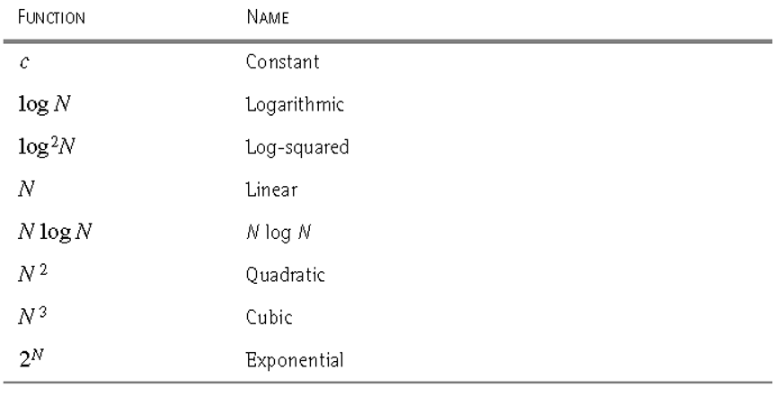
算法分析中常见的复杂性函数

Slide 39
§2 Asymptotic Notation

Slide 40
§2 Asymptotic Notation
2^{n}
n²
n log n
f
n
Log n
n

Slide 41
§2 Asymptotic Notation
n
μs = microsecond = 10⁻⁶ seconds
ms = millisecond = 10⁻³ seconds
sec = seconds
min = minutes yr = years
hr = hours
d = days

Slide 42
§2 Asymptotic Notation
〖Example〗 Matrix addition
void add ( int a[ ][ MAX_SIZE ],
int b[ ][ MAX_SIZE ],
int c[ ][ MAX_SIZE ],
int rows, int cols )
{
int i, j ;
for ( i = 0; i < rows; i++ )
for ( j = 0; j < cols; j++ )
c[ i ][ j ] = a[ i ][ j ] + b[ i ][ j ];
}
/* Θ (rows) */
/* Θ (rows * cols ) */
/* Θ (rows * cols ) */
T(rows, cols ) = Θ (rows * cols )

Slide 43
§2 Asymptotic Notation
General Rules
☞ FOR LOOPS: The running time of a for loop is at most the running time of the statements inside the for loop (including tests) times the number of iterations.
☞ NESTED FOR LOOPS: The total running time of a statement inside a group of nested loops is the running time of the statements multiplied by the product of the sizes of all the for loops.
☞ CONSECUTIVE STATEMENTS: These just add (which means that the maximum is the one that counts).
☞ IF / ELSE: For the fragment
if ( Condition ) S1;
else S2;
the running time is never more than the running time of the test plus the larger of the running time of S1 and S2.

Slide 44

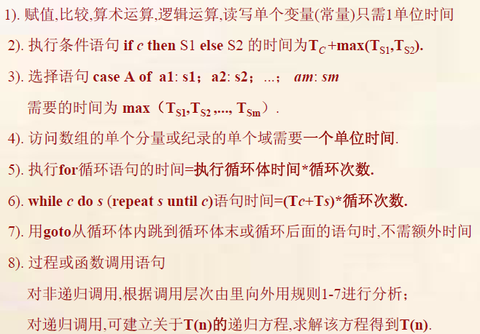

Slide 45
§2 Asymptotic Notation
☞ RECURSIONS:
〖Example〗 Fibonacci number:
Fib(0) = Fib(1) = 1, Fib(n) = Fib(n−1) + Fib(n−2)
long int Fib ( int N )
{
if ( N <= 1 )
return 1;
else
return Fib( N − 1 ) + Fib( N − 2 );
}
/* T ( N ) */
Q: Why is it
so bad?
/* O( 1 ) */
/* O( 1 ) */
/*O(1)*/
/*T(N −1)*/
/*T(N −2)*/
T(N) = T(N −1) + T(N −2) + 2
≥ Fib(N)
Proof by induction
T(N) grows exponentially

Slide 46
3.递归方程渐近阶的求解
站得高，看的远

Slide 47
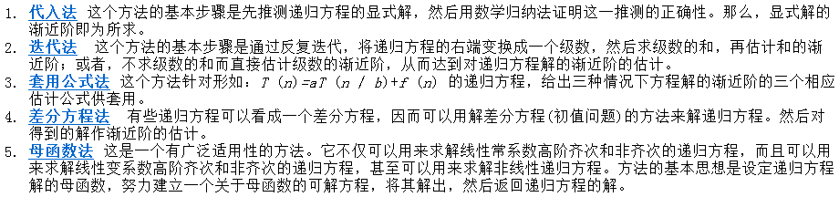
递归方程解的渐近阶的求法

Slide 48
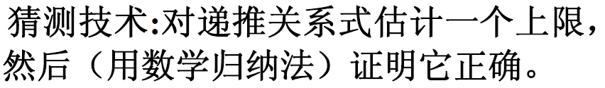
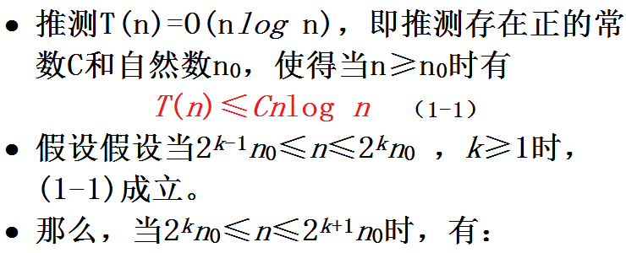
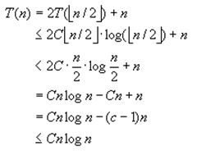
代入法

Slide 49
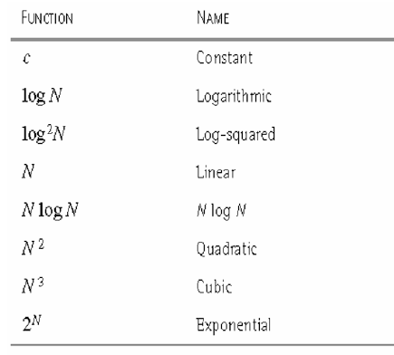
算法复杂性分析中常见函数
这个方法的局限性在于它只适合容易推测出答案的递归方程或善于进行推测的高手。推测递归方程的正确解，没有一般的方法，得靠经验的积累和洞察力。

Slide 50

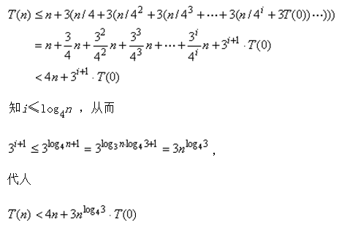
迭代法
即，T(n)=O(n)

Slide 51
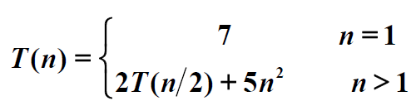
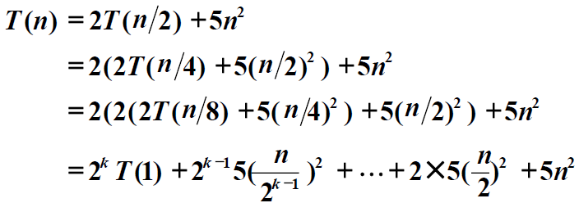

Slide 52

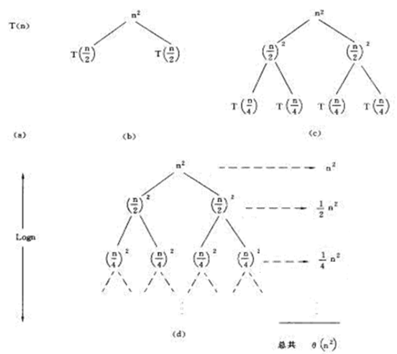

Slide 53
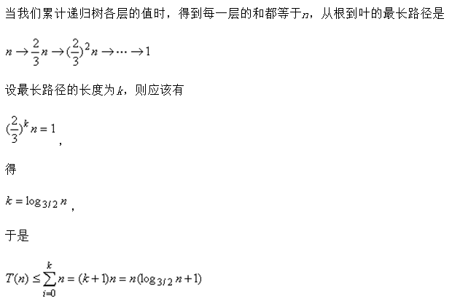
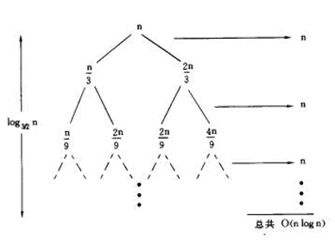

Slide 54
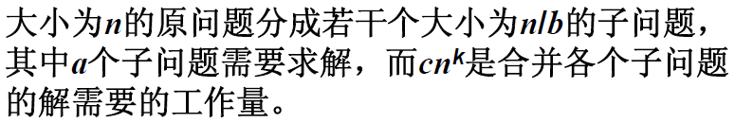
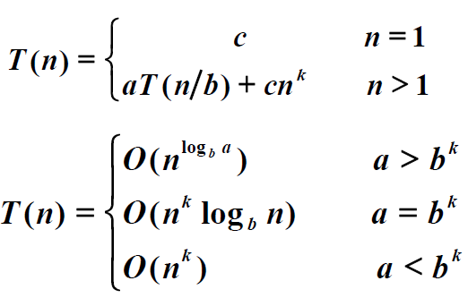
套用公式法

Slide 55
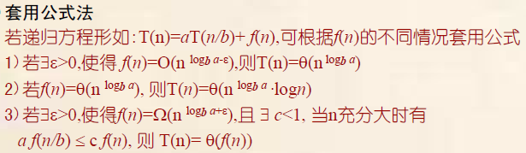

Slide 56
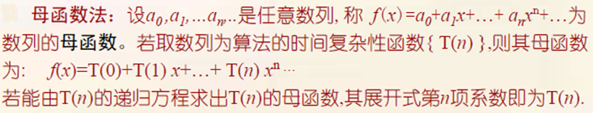
母函数法

Slide 57
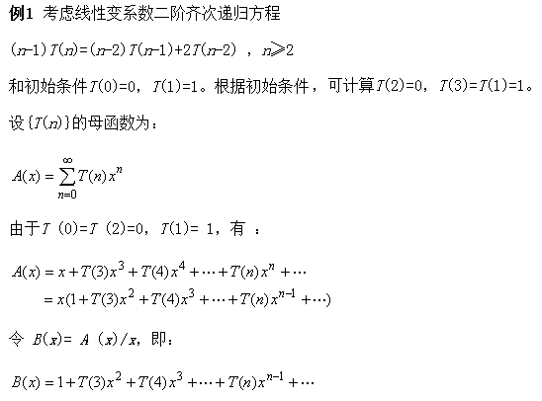

Slide 58
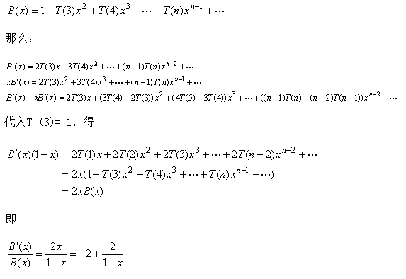

Slide 59
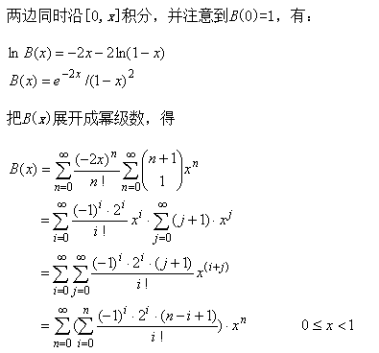

Slide 60
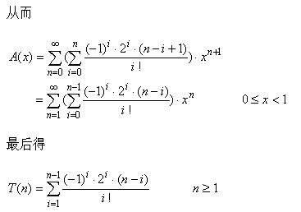

Slide 61
4.实例算法复杂性分析
站得高，看的远

Slide 62
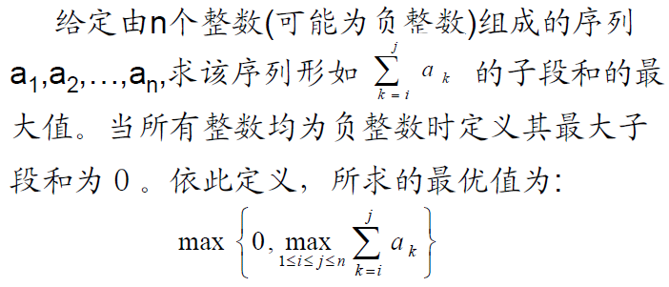
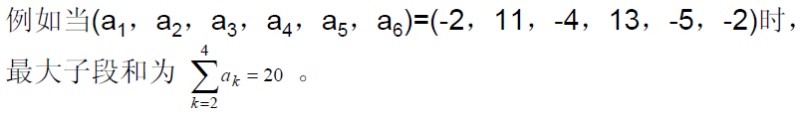
§3 Compare the Algorithms
〖Example〗 Given (possibly negative) integers A₁, A₂, …, A_{N}, find the maximum value of

Slide 63
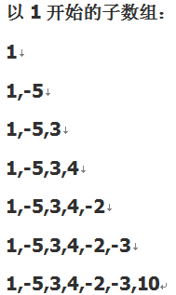
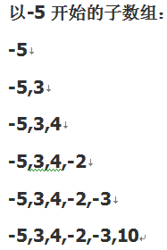
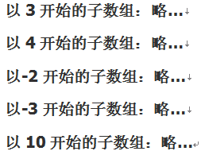
1,-5, 3,4,-2,-3,10
枚举后再对所有的子数组求和，可以得到如下代码

Slide 64

§3 Compare the Algorithms
〖Example〗 Given (possibly negative) integers A₁, A₂, …, A_{N}, find the maximum value of
Algorithm 1
int MaxSubsequenceSum ( const int A[ ], int N )
{
int ThisSum, MaxSum, i, j, k;
/* 1*/ MaxSum = 0; /* initialize the maximum sum */
/* 2*/ for( i = 0; i < N; i++ ) /* start from A[ i ] */
/* 3*/ for( j = i; j < N; j++ ) { /* end at A[ j ] */
/* 4*/ ThisSum = 0;
/* 5*/ for( k = i; k <= j; k++ )
/* 6*/ ThisSum += A[ k ]; /* sum from A[ i ] to A[ j ] */
/* 7*/ if ( ThisSum > MaxSum )
/* 8*/ MaxSum = ThisSum; /* update max sum */
} /* end for-j and for-i */
/* 9*/ return MaxSum;
}
Detailed analysis is your first homework.
T( N ) = O( N³ )

Slide 65
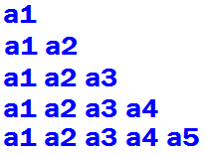
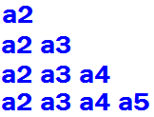

Algorithm 1
int MaxSubsequenceSum ( const int A[ ], int N )
{
int ThisSum, MaxSum, i, j, k;
/* 1*/ MaxSum = 0; /* initialize the maximum sum */
/* 2*/ for( i = 0; i < N; i++ ) /* start from A[ i ] */
/* 3*/ for( j = i; j < N; j++ ) { /* end at A[ j ] */
/* 4*/ ThisSum = 0;
/* 5*/ for( k = i; k <= j; k++ )
/* 6*/ ThisSum += A[ k ]; /* sum from A[ i ] to A[ j ] */
/* 7*/ if ( ThisSum > MaxSum )
/* 8*/ MaxSum = ThisSum; /* update max sum */
} /* end for-j and for-i */
/* 9*/ return MaxSum;
}
Detailed analysis is your first homework.
T( N ) = O( N³ )

Slide 66
§3 Compare the Algorithms
Algorithm 2
int MaxSubsequenceSum ( const int A[ ], int N )
{
int ThisSum, MaxSum, i, j;
/* 1*/ MaxSum = 0; /* initialize the maximum sum */
/* 2*/ for( i = 0; i < N; i++ ) { /* start from A[ i ] */
/* 3*/ ThisSum = 0;
/* 4*/ for( j = i; j < N; j++ ) { /* end at A[ j ] */
/* 5*/ ThisSum += A[ j ]; /* sum from A[ i ] to A[ j ] */
/* 6*/ if ( ThisSum > MaxSum )
/* 7*/ MaxSum = ThisSum; /* update max sum */
} /* end for-j */
} /* end for-i */
/* 8*/ return MaxSum;
}
T( N ) = O( N² )

Slide 67
§3 Compare the Algorithms
Algorithm 3
Divide and Conquer
conquer
divide
4
−3
5
−2
−1
2
6
−2
4
5
2
6
6
8
11
T ( N/2 )
O( N )
T ( N/2 )
T ( N ) = 2 T( N/2 ) + c N , T(1) = O(1)
The program would be discussed later.
Also true for N ≠ 2^{k}
= 2 [2 T( N/2² ) + c N/2] + c N
= 2^{k} O(1) + c k N where N/2^{k} = 1
= O( N log N )

Slide 68
§3 Compare the Algorithms
Algorithm 4
On-line Algorithm
int MaxSubsequenceSum( const int A[ ], int N )
{
int ThisSum, MaxSum, j;
/* 1*/ ThisSum = MaxSum = 0;
/* 2*/ for ( j = 0; j < N; j++ ) {
/* 3*/ ThisSum += A[ j ];
/* 4*/ if ( ThisSum > MaxSum )
/* 5*/ MaxSum = ThisSum;
/* 6*/ else if ( ThisSum < 0 )
/* 7*/ ThisSum = 0;
} /* end for-j */
/* 8*/ return MaxSum;
}
−1
−1
3
3 −2 4 −6
−2
4
−6
1
6
−1
At any point in time, the algorithm can correctly give an answer to the subsequence problem for the data it has already read.
T( N ) = O( N )
A[ ] is scanned once only.

Slide 69

§3 Compare the Algorithms
Running times of several algorithms for maximum subsequence sum (in seconds)
Algorithm
1
2
3
4
Time
O( N³ )
O( N² )
O(N log N)
O( N )
Input Size
N =10
N =100
N =1,000
N =10,000
N =100,000
0.00103
0.47015
448.77
NA
NA
0.00045
0.01112
1.1233
111.13
NA
0.00066
0.00486
0.05843
0.68631
8.0113
0.00034
0.00063
0.00333
0.03042
0.29832
Note: The time required to read the input is not included.

Slide 70
§4 Logarithms in the Running Time
〖Example〗 Binary Search:
Given: A [0] ≤ A [1] ≤ …… ≤ A [N − 1] ; X
Task: Find X
Output: i if X = = A [ i ]
−1 if X is not found
low
mid
high
X ~ A [mid]
<
==
>
low
high = mid − 1
low= mid + 1
high
mid

Slide 71
§4 Logarithms in the Running Time
int BinarySearch ( const ElementType A[ ],
ElementType X, int N )
{
int Low, Mid, High;
/* 1*/ Low = 0; High = N - 1;
/* 2*/ while ( Low <= High ) {
/* 3*/ Mid = ( Low + High ) / 2;
/* 4*/ if ( A[ Mid ] < X )
/* 5*/ Low = Mid + 1;
else
/* 6*/ if ( A[ Mid ] > X )
/* 7*/ High = Mid - 1;
else
/* 8*/ return Mid; /* Found */
} /* end while */
/* 9*/ return NotFound; /* NotFound is defined as -1 */
}
T(N) = ?
Very useful in case the data are static and is in sorted order (e.g. find words from a dictionary).
T_{worst}( N ) = O( log N )

Slide 72
§4 Logarithms in the Running Time
〖Example〗 Euclid’s Algorithm: computing the greatest common divisor (Gcd).
unsigned int Gcd ( unsigned int M, unsigned int N )
{
unsigned int Rem;
/* 1*/ while ( N > 0 ) {
/* 2*/ Rem = M % N;
/* 3*/ M = N;
/* 4*/ N = Rem;
} /* end while */
/* 5*/ return M;
}
T(N) = ?
T(N) < 1 + T ( M/2 )
< 2 + T ( N/2 )
… …
< k + T ( N/2^{k} )
【Theorem】 If M > N, then ( M mod N ) < M / 2.
T( N ) = O( log N )

Slide 73
§4 Logarithms in the Running Time
〖Example〗 Exponentiation: computing X ^{N}.
long int Pow ( long int X, unsigned int N )
{
long int P = 1;
while ( N -- ) P *= X;
return P;
}
T( N ) = O( N )
long int Pow ( long int X, unsigned int N )
{
/* 1*/ if ( N == 0 )
/* 2*/ return 1;
/* 3*/ if ( N == 1 )
/* 4*/ return X;
/* 5*/ if ( IsEven( N ) )
/* 6*/ return Pow( X * X, N / 2 );
else
/* 7*/ return Pow( X * X, N / 2 ) * X;
}
return Pow( Pow(X, 2), N / 2 );
return Pow( Pow(X, N / 2), 2);
return
Pow(X, N / 2) * Pow(X, N / 2);
Is it necessary ?
T( N ) = O( log N )

Slide 74
§5 Checking Your Analysis
When T(N) = O(N), check if T(2N)/T(N) ≈ 2
When T(N) = O(N²), check if T(2N)/T(N) ≈ 4
When T(N) = O(N³), check if T(2N)/T(N) ≈ 8
… …
Method 1
Method 2
When T(N) = O( f (N) ), check if
Read the example given on p.28 (Figures 2.12 & 2.13).

Slide 75
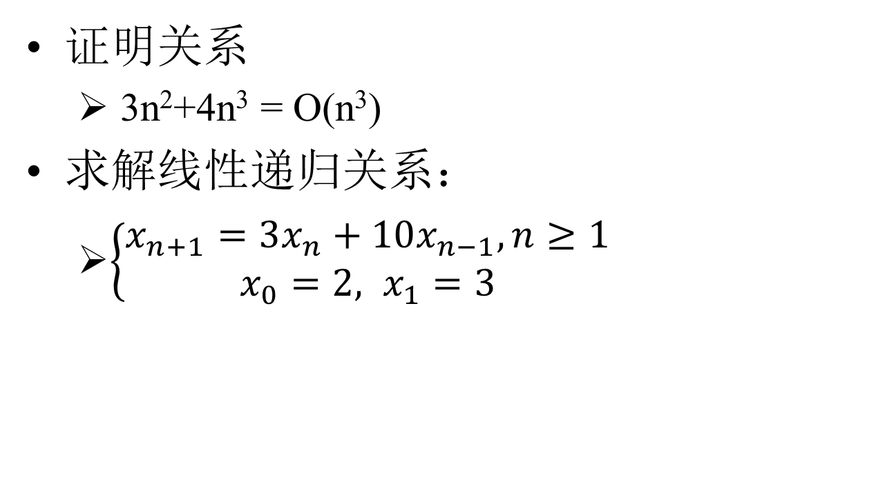
Homework 1
Proof and compute.

Slide 76

Homework 2
Analyzing Algorithm1和4。
Real Programmers
don't comment their code.
If it was hard to write,
it should be hard to understand
and harder to modify.
I will not read and grade
any program which has
less than 30% lines
commented.
Don’t forget to sign
you names
and duties at the end of
your report.

Slide 77
Thank you for listening
Notes:
模板来自于 http://docer.wps.cn

